Slide 1
CREATE YOUR OWN ANIME CHARACTER USING GANs
CREATED BY
S.ABISHAKE KANNAN
REG.No.:912321104301
B.E CSE-III year
SACS MAVMM ENGINEERING COLLEGE,MADURAI.

Slide 2
Project outline
problem statement
Proposed system/solution
System development approach
Algorithm and deployment
Result
Reference
Conclusion

Slide 3
Problem statement:
Anime, with its diverse and imaginative characters, has captured the hearts of audiences worldwide. However, creating original anime characters that resonate with viewers requires significant artistic skill and creativity.

Slide 4
Proposed system/solution
1.Data Collection and Preprocessing:
Gather a laprge dataset of anime characters from various sources like anime series, manga, or artwork repositories. Ensure that the dataset covers a wide range of styles, genders, ages, and features.
2.GAN Architecture:
Choose a suitable GAN architecture for generating anime characters. Common choices include Deep Convolutional GANs (DCGANs), Progressive GANs, or StyleGAN.
Design the generator network to take random noise vectors as input and output anime character images. The architecture should be capable of capturing the intricate details and stylistic nuances of anime artwork.

Slide 5
Proposed system/solution (contd...)
3.Training the GAN:
Train the GAN on the preprocessed dataset. This involves optimizing the generator and discriminator networks in an adversarial manner.
Use techniques such as mini-batch discrimination, feature matching, and spectral normalization to stabilize training and improve the quality of generated images.
4.Evaluation and Fine-tuning:
Evaluate the trained GAN using qualitative and quantitative metrics such as visual inspection, perceptual similarity scores, and Frechet Inception Distance (FID).
Fine-tune the GAN architecture and training process based on the evaluation results to further enhance the quality and diversity of generated anime characters.

Slide 6
Proposed System /Solution (contd..)
5.User Interface (UI):
Develop a user-friendly interface for users to interact with the GAN and create their custom anime characters.
The UI should allow users to adjust various parameters such as gender, hairstyle, facial features, clothing, and accessories.
6.Integration and Deployment:
Integrate the trained GAN model with the UI to enable seamless generation of anime characters based on user preferences.
Deploy the system on a suitable platform such as a web application, desktop software, or mobile app, making it accessible to a wide audience of anime enthusiasts.

Slide 7
Proposed system/solution (contd..)
7.Feedback and Iteration:
Gather feedback from users to identify areas for improvement and new features.
Iterate on the system based on user feedback, incorporating enhancements to the GAN model, UI, and functionality to continuously enhance the user experience.

Slide 8
System Development Approach
Data Collection:
Gather a large dataset of existing anime characters. This dataset will serve as the training data for your GAN. You can scrape images from various anime websites or use publicly available datasets.
Preprocessing:
Clean and preprocess the collected data. This may involve standardizing image sizes, removing duplicates, and ensuring consistency in the dataset.
Training the GAN:
Implement and train a GAN architecture suitable for generating anime characters. GANs consist of two neural networks – a generator and a discriminator – that are trained simultaneously in a competitive setting.

Slide 9
System development approach (contd..)
Hyperparameters Tuning:
Experiment with different hyperparameters such as learning rate, batch size, and architecture choices to optimize the performance of your GAN.
Generating Anime Characters:
Once the GAN is trained, you can use the generator network to produce new anime character images. You can sample from the generator's latent space to generate diverse and novel characters.
Post-processing:
Optionally, you can apply post-processing techniques to enhance the generated images, such as adding background scenes, adjusting colors, or refining details.

Slide 10
System development approach (contd...)
Evaluation:
Assess the quality of the generated anime characters. This could involve qualitative evaluation by human judges or quantitative metrics such as Frechet
Inception Distance (FID) to measure the similarity between generated and real images.
Iterative Improvement:
Based on feedback and evaluation results, iterate on your GAN architecture and training process to further improve the quality of generated anime characters.
Deployment:
Deploy your system for creating custom anime characters, either as a standalone application, a web service, or integrated into existing platforms or games.

Slide 11
Algorithm and deployment
Data Collection:
Gather a large dataset of anime images. You can use sources like online repositories, image-sharing platforms, or even scrape images from anime websites (ensuring you respect copyright laws).
Data Preprocessing:
Preprocess the images to ensure they are of consistent size and quality. You may need to resize images, remove noise, and perform other preprocessing steps to standardize the dataset.

Slide 12
Algorithm and deployment (contd..)
Model Selection:
Choose a GAN architecture suitable for generating anime images. Popular choices include DCGAN (Deep Convolutional GAN), StyleGAN, or BigGAN. Consider factors like model complexity, training time, and quality of generated images.
Model Training :
Train the selected GAN architecture on your dataset. This involves feeding the images to the GAN and optimizing its parameters through an adversarial training process. Training can take a considerable amount of time, depending on the size of your dataset and the complexity of the chosen model.

Slide 13
Algorithm and deployment (contd..)
Evaluation:
Evaluate the trained model to assess the quality of the generated images. This can be done visually by inspecting generated samples or using quantitative metrics like Inception Score or Frechet Inception Distance (FID).
Fine-tuning (Optional):
Fine-tune the model if necessary to improve the quality of generated images. This might involve adjusting hyperparameters, using techniques like progressive growing, or training for additional epochs.

Slide 14
Algorithm and deployment (contd..)
Deployment:
Once you're satisfied with the trained model, deploy it to generate new anime images. This can be done through various methods, including
Building a web application where users can input parameters (e.g., character traits, scene settings) and receive generated anime images.
Continuous Improvement:
Monitor the performance of the deployed model and gather feedback from users. Consider retraining the model with additional data or fine-tuning it based on user feedback to improve the quality of generated images over time.`

Slide 15
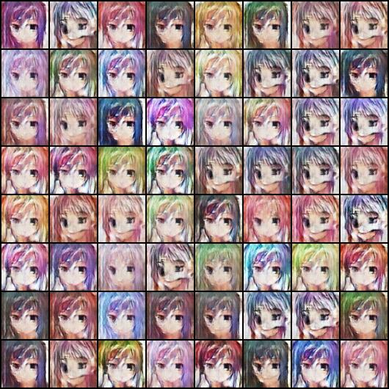
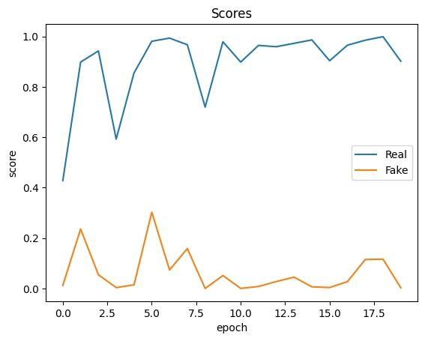
Result
Fig. : Generative Adversarial network for manga- face generation
Fig. : Creating New anime faces with generative adversarial networks(GANS)

Slide 16
Reference
https://numpy.org/
https://matplotlib.org/
Htthttps://html.org/
Data set link
https://www.kaggle.com/datasets/diraizel/anime-images-dataset/code

Slide 17
Conclusion
In conclusion, leveraging Generative Adversarial Networks (GANs) to create your own anime characters presents an innovative and exciting avenue for artistic expression.

Slide 18
Thank you

